Slide 1
Problem Identification
Big Mountain Resort has recently installed an additional chair lift which has increased their operating costs by $1,540,000 this season.
Select a better value for their ticket price to offset the additional operating cost
Reduce costs without undermining the ticket price and increase the ticket price by providing commensurate value.

Slide 2
Recommendation and key findings
Most important features for the resort in terms of ticket pricing are
fastQuads
Runs
Snow Making_ac
vertical_drop

Slide 3
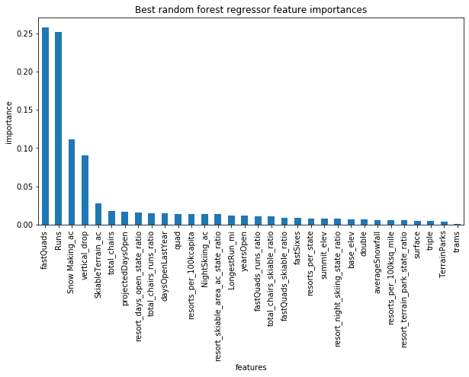

Slide 4
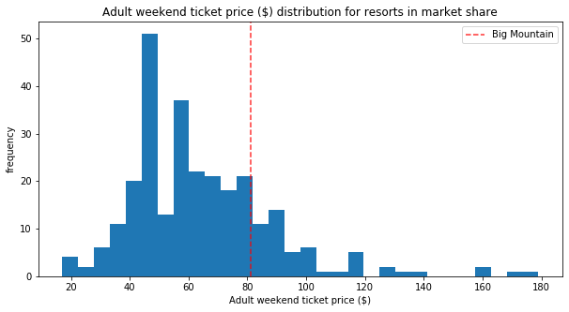

Slide 5
Modeling results and analysis
We chose the random forest model to predict the ticket price.
Big Mountain is currently charging $81 and the Big Mountain resort modelled price is $94.22 with an expected mean absolute error of $10.39, which suggests there is room for an increase in the ticket price.
The ski resort is undercharging when compared with other resorts throughout the US
By further adding another Run and increasing the vertical drop by 150 feet and installing an additional chair lift, it supports an additional price increase by $1.99 and total revenue increase by $3,474,638.

Slide 6
Summary and conclusion
Big Mountain was already fairly high on some of the league charts of facilities offered, but it undervalued its facilities.
The current ticket price can be safely increased and it will easily cover the additional operating cost of the newly added lift and also generate more revenues for the business.
The business can definitely use this model in the future in case any feature is added or removed and the price has to be adjusted accordingly.

